Slide 1


NLP学习：第六期
HIT-SCIR
王兴昊
2021年8月17日

Slide 2
目录
书籍
第5章：静态词向量预训练模型
第6章：动态词向量预训练模型
第7章：预训练语言模型
CS 224n: Assignment #5

Slide 3
静态词向量预训练模型
神经网络语言模型
词的分布式表示：词向量
更先进的神经网络模型（RNN、Transformer等）

Slide 4
静态词向量预训练模型
预训练任务
前馈神经网络语言模型
循环神经网络语言模型

Slide 5
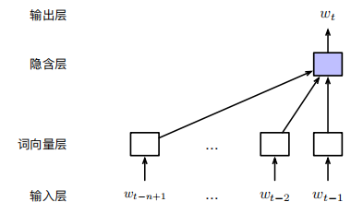
静态词向量预训练模型
前馈神经网络语言模型
P(wt|w1:t−1) = P(wt|wt−n+1:t−1)
输入层、词向量层、隐含层、输出层

Slide 6
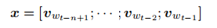
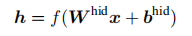
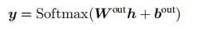
静态词向量预训练模型
输入层
独热编码或每个词在词表中的位置下标
词向量层
Look-up table
隐含层
输出层
对h进行线性变换，利用Softmax函数进行归一化

Slide 7
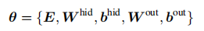
静态词向量预训练模型
前馈神经网络语言模型
自由参数
参数数量
V：词表
d：词向量维度
m：隐藏层维度
n：马尔科夫假设中的n-1个词
训练完成后，矩阵E为预训练得到的静态词向量

Slide 8
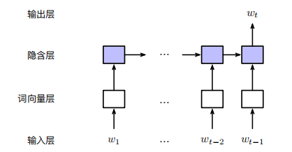
静态词向量预训练模型
循环神经网络语言模型
−1) = P(wt|wt−n+1:t−1)
他 喜欢 吃 苹果
他 感冒 了 ， 于是 下班 后 去 医院
输入层、词向量层、隐含层、输出层

Slide 9
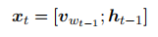
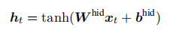
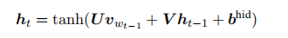
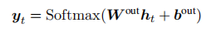
静态词向量预训练模型
输入层
完整的历史词序列构成
词向量层
t时刻的输入由前一个词的词向量以及t-1时刻的隐含状态组成
隐含层
体现循环神经网络的递归特性
输出层

Slide 10
静态词向量预训练模型
Word2Vec词向量：基于词与词的共现信息构建词向量
CBOW模型
Skip-gram模型
负采样

Slide 11
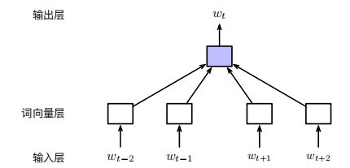
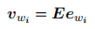
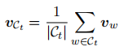
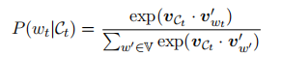
静态词向量预训练模型
CBOW模型：Continuous Bag-of-Words
根据上下文预测目标词
输入层
独热向量
词向量层
输出层

Slide 12
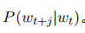
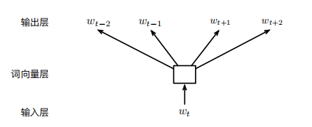
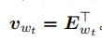
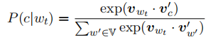
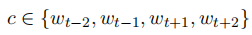
静态词向量预训练模型
Skip-gram模型
根据当前词来预测上个的词
输入层
当前时刻的独热向量
词向量层
输出层

Slide 13
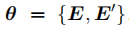
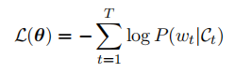
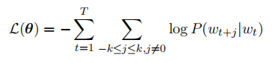
静态词向量预训练模型
参数估计
CBOW模型：
Skip-gram模型：

Slide 14
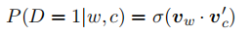
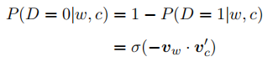
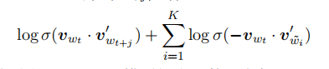
静态词向量预训练模型
负采样
规避输出层概率归一化计算效率的影响
c与w共现概率：
不共现概率：
Skip-gram模型的损失函数：

Slide 15
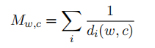
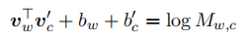
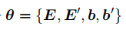
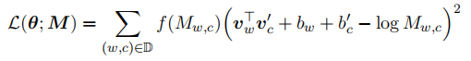
静态词向量预训练模型
Glove词向量：基于矩阵分解的方法
预训练任务
”词-上下文“共现矩阵M，引入共现距离概念
利用词与上下文向量表示对M中的元素进行回归
参数估计
损失函数：

Slide 16
动态词向量预训练模型
词向量：从静态到动态
他 亲自 下场 参加 比赛
他 竟 落得 如此 下场
上下文相关词向量，即动态词向量

Slide 17
动态词向量预训练模型
基于语言模型的动态词向量预训练
双向语言模型
ELMo词向量：Embedding from Language Models

Slide 18
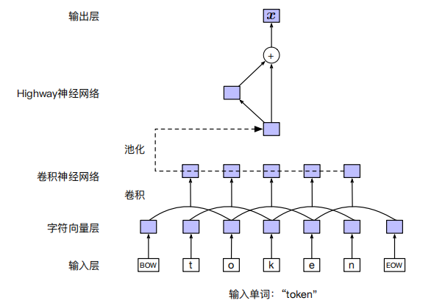
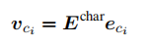
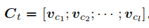
动态词向量预训练模型
双向语言模型
给定输入文本，从前向和后向两方向同时建立语言模型
输入表示层
经1D卷积、Pooling、Highway，
得词的定长向量表示

Slide 19
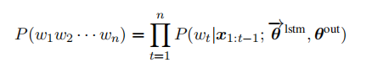
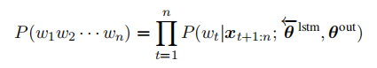
动态词向量预训练模型
双向语言模型
前向语言模型
后向语言模型

Slide 20
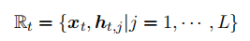
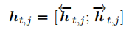
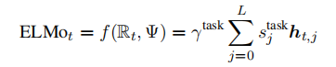
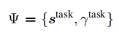
动态词向量预训练模型
ELMo词向量
不同层次的隐含层向量蕴含了不同层次或粒度的文本信息
对不同层次的向量表示进行加权平均
均与下游任务相关

Slide 21
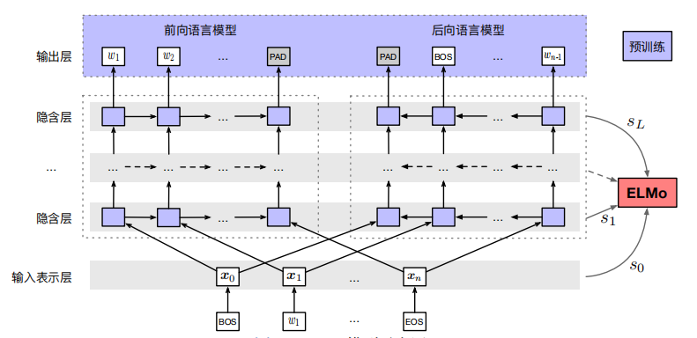
动态词向量预训练模型
ELMo模型：整体结构回顾

Slide 22
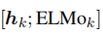
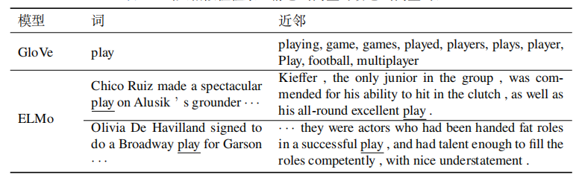
动态词向量预训练模型
ELMo模型：应用与评价
作为下游任务特征
上下文相关的词义相似性检索

Slide 23
预训练语言模型
概述：预训练+精调
大数据：“保质”+“保量”
大模型：并行+上下文信息
大算力：图形处理单元（GPU）+张量处理单元（TPU）
GPT：基于自回归的预训练语言模型
BERT：基于自编码的预训练语言模型

Slide 24
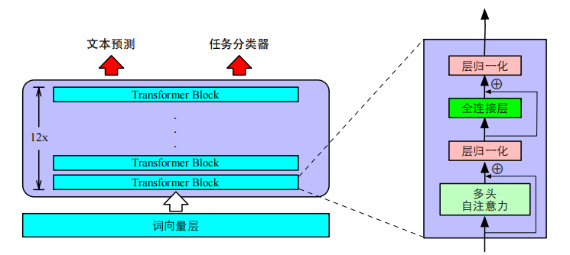
预训练语言模型
GPT：NLP新范式——生成式预训练+判别式任务精调
GPT：无监督预训练
基于Transformer的单向语言模型：从左到右对输入文本建模

Slide 25
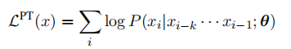
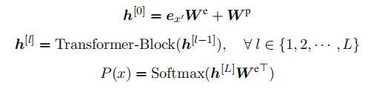
预训练语言模型
最大似然估计

Slide 26
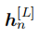
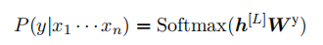
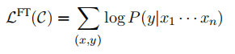
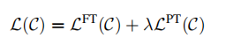
预训练语言模型
GPT：有监督下游任务fine-tuning
每个样例输入为 ，与之对应的标签为y
获取最后一层的最后一个词对应的隐藏层输出
将其通过一层全连接层变换，预测最终标签：
优化损失函数对下游任务进行精调：
灾难性遗忘？

Slide 27
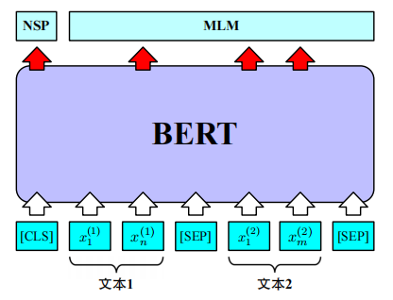
预训练语言模型
BERT：整体结构
多层Transformer，包含两个预训练任务：掩码语言模型（MLM）、下一个句子预测（NSP）

Slide 28
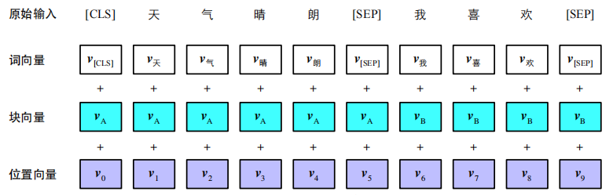

预训练语言模型
BERT：输入表示
词向量（Token Embedding）、块向量（Segment Embedding）、位置向量（Position Embedding）

Slide 29







预训练语言模型
BERT：输入表示
词向量计算
块向量计算
单个块？两个块？
位置向量计算
绝对位置

Slide 30

预训练语言模型
BERT：基本预训练任务——MLM
“完形填空”：将输入文本中的部分单词进行mask，并通过深层Transformer还原为元单词
BERT采用15%的mask比例，[MASK]标记替换
预训练与fine-tuning的不一致？

Slide 31






预训练语言模型
BERT：基本预训练任务——MLM
输入层
占位标记
截断
BERT编码层
输出层

Slide 32

预训练语言模型
BERT：基本预训练任务——NSP
二分类任务：句子B是否是句子A的下一个句子
训练样本：正样本、负样本
1:1
无监督学习任务

Slide 33



预训练语言模型
BERT：基本预训练任务——NSP
输入层
BERT编码层
输出层
使用[CLS]位的隐含层表示进行分类预测 h0

Slide 34



预训练语言模型
BERT：更多预训练任务？
整词掩码（Whole Word Masking，WWM）

Slide 35

预训练语言模型
BERT：更多预训练任务？
N-gram掩码（N-gram Masking，NM）

Slide 36

CS 224n: Assignment #5
Character-based convolutional encoder for NMT

Slide 37
Assignment #5: Character-based convolutional encoder for NMT
(a) In Assignment 4 we used 256-dimensional word embeddings (e_{word} = 256), while in this assignment, it turns out that a character embedding size of 50 suffices (e_{char} = 50). In 1-2 sentences, explain one reason why the embedding size used for character-level embeddings is typically lower than that used for word embeddings.
A: 一个单词相比一个字符，其携带的信息（如词性、语义等）显然更多；一个单词由多个字符构成，字符的嵌入维度理应比单词少。

Slide 38



Assignment #5: Character-based convolutional encoder for NMT
(b) Write down the total number of parameters in the character-based embedding model, then do the same for the word-based lookup embedding model. Write each answer as a single expression (though you may show working) in terms of e_{char}, k, e_{word}, V_{word} (the size of the word-vocabulary in the lookup embedding model) and V_{char} (the size of the character-vocabulary in the character-based embedding model).
A: 嵌入层 e_{word}；卷积核参数 ，以及bias ；
Highway层及其bias ；
注意：f=e_{word}
结果：V_{char}×e_{word}+f×e_{char}×k+f+2×e_{word}×e_{word}+2×e_{word}
word-based lookup embedding model：V_{word}×e_{word}

Slide 39
Assignment #5: Character-based convolutional encoder for NMT
(c) In step 3 of the character-based embedding model, instead of using a 1D convnet, we could have used a RNN instead (e.g. feed the sequence of characters into a bidirectional LSTM and combine the hidden states using max-pooling). Explain one advantage of using a convolutional architecture rather than a recurrent architecture for this purpose, making it clear how the two contrast.
样例答案: When a 1D convnet computes features for a given window of the input, those features depend on the window only – not any other inputs to the left or right. By contrast, a RNN needs to compute the hidden states sequentially, from left to right (and also right to left, if the RNN is bidirectional). Therefore, unlike a RNN, a convnet’s features can be computed in parallel, which means that convnets are generally faster, especially for long sequences.

Slide 40
Assignment #5: Character-based convolutional encoder for NMT
(c) In step 3 of the character-based embedding model, instead of using a 1D convnet, we could have used a RNN instead (e.g. feed the sequence of characters into a bidirectional LSTM and combine the hidden states using max-pooling). Explain one advantage of using a convolutional architecture rather than a recurrent architecture for this purpose, making it clear how the two contrast.
A: 1Dconvnet的参数比RNN少；
RNN计算每个位置的上下文表示时，将（从左往右）获得的信息存储到一个定长向量中；1Dconvnet利用多个filter来获取不同的特征，经过拼接可以获得不同长度的表示，可以使用不同的attention head以捕获特征。

Slide 41
Assignment #5: Character-based convolutional encoder for NMT
(d) In lectures we learned about both max-pooling and average-pooling. For each pooling method, please explain one advantage in comparison to the other pooling method. For each advantage, make it clear how the two contrast, and write to a similar level of detail as in the example given in the previous question.
A: max-pooling：优点：保留了最显著的特征；缺点：遗弃了大部分信息。
mean-pooling：优点：将所有信息都保留了；缺点：稀释了较为明显的特征。

Slide 42
Assignment #5: Character-based convolutional encoder for NMT
(e) In vocab.py, implement the method words2charindices() (hint: copy the structure of words2indices()) to convert each character to its corresponding index in the character-vocabulary.
def words2charindices(self, sents):
""" Convert list of sentences of words into list of list of list of character indices.
@param sents (list[list[str]]): sentence(s) in words
@return word_ids (list[list[list[int]]]): sentence(s) in indices
"""
### YOUR CODE HERE for part 1e
return [[[self.start_of_word]+[self.char2id[c] for c in w]+[self.end_of_word] for w in s] for s in sents]
### END YOUR CODE

Slide 43
Assignment #5: Character-based convolutional encoder for NMT
(f) Implement pad_sents_char() in utils.py, similar to the version for words. This method should pad at the character and word level. All words should be padded/truncated to max word length m_{word} = 21, and all sentences should be padded to the length of the longest sentence in the batch. A padding word is represented by mword <PAD>-characters.

Slide 44
Assignment #5: Character-based convolutional encoder for NMT
def pad_sents_char(sents, char_pad_token):
""" Pad list of sentences according to the longest sentence in the batch and max_word_length.
@param sents (list[list[list[int]]]): list of sentences, result of `words2charindices()` from `vocab.py`
@param char_pad_token (int): index of the character-padding token
@returns sents_padded (list[list[list[int]]]): list of sentences where sentences/words shorter than the max length sentence/word are padded out with the appropriate pad token, such that each sentence in the batch now has same number of words and each word has an equal number of characters
Output shape: (batch_size, max_sentence_length, max_word_length)
"""
# Words longer than 21 characters should be truncated
max_word_length = 21
### YOUR CODE HERE for part 1f

Slide 45
Assignment #5: Character-based convolutional encoder for NMT
sents_padded = []
max_len = max(len(s) for s in sents)#测量句子最大长度
for s in sents:
pad_sent = []
for w in s:
if len(w)<max_word_length:
pad_sent.append(w+[char_pad_token]*(max_word_length-len(w))) #pad
else:
pad_sent.append(w[:max_word_length]) #truncate
if len(pad_sent) < max_len: #pad
pad_sent.extend([char_pad_token]*max_word_length for i in range(max_len-len(pad_sent)))
sents_padded.append(pad_sent)
### END YOUR CODE
return sents_padded

Slide 46
Assignment #5: Character-based convolutional encoder for NMT
(g) Implement to input_tensor_char() in vocab.py to connect the previous two parts: use both methods created in the previous steps and convert the resulting padded sentences to a torch tensor.
def to_input_tensor_char(self, sents: List[List[str]], device: torch.device) -> torch.Tensor:
""" Convert list of sentences (words) into tensor with necessary padding for shorter sentences.
@param sents (List[List[str]]): list of sentences (words)
@param device: device on which to load the tensor, i.e. CPU or GPU
@returns sents_var: tensor of (max_sentence_length, batch_size, max_word_length)
"""
### YOUR CODE HERE for part 1g
### TODO:
sents = self.words2charindices(sents)
tensor = pad_sents_char(sents,self.char2id['<pad>'])
tensor = torch.tensor(tensor,dtype=torch.long,device = device)
return tensor.permute([1,0,2]) # reshape the dimensions
### END YOUR CODE

Slide 47
Assignment #5: Character-based convolutional encoder for NMT
(h) In the empty file highway.py, implement the highway network as a nn.Module class called Highway.
import torch.nn as nn
import torch
import torch.nn.functional as F
### YOUR CODE HERE for part 1h
class Highway(nn.Module):
def __init__(self,e_word):
""" initial two Linear to construct highway connection
@param (int):the dimention of the word
"""
super(Highway,self).__init__()
self.proj = nn.Linear(e_word, e_word)
self.gate = nn.Linear(e_word, e_word)

Slide 48

Assignment #5: Character-based convolutional encoder for NMT
def forward(self,conv_out:torch.Tensor) -> torch.Tensor:
""" highway connection
@param conv_out (torch.Tensor): the convolution layer's output,its shape is (batch_size, e_word)
@return highway_out (torch.Tensor): tensor of (batch_size, e_word)
"""
x_proj = F.relu(self.proj(conv_out))
x_gate = torch.sigmoid(self.gate(conv_out))
highway_out = torch.mul(x_proj,x_gate) + torch.mul(conv_out,1-x_gate)
return highway_out
### END YOUR CODE

Slide 49
Assignment #5: Character-based convolutional encoder for NMT
(i) In the empty file cnn.py, implement the convolutional network as a nn.Module class called CNN.
import torch.nn as nn
import torch
import torch.nn.functional as F
### YOUR CODE HERE for part 1i
class CNN(nn.Module):
def __init__(self,e_char,filter_size,m_word = 21,kernel_size = 5):
"""initial cnn
@param filter_size (int): the number of filter,also the e_word
@param e_char (int): the demention of char
@param kernel_size (int): the filter's length
"""
super(CNN,self).__init__()
self.conv1d = nn.Conv1d(e_char,filter_size,kernel_size)#字符向量维度，filter数量，卷积核大小
self.pool = nn.MaxPool1d(m_word - kernel_size + 1) #窗口大小

Slide 50

Assignment #5: Character-based convolutional encoder for NMT
def forward(self,reshaped) -> torch.Tensor:
"""
@param reshaped (torch.Tensor): the char embedding of sentences, which is tensor of (batch_size,e_char,max_word_len)
@return conv_out (torch.Tensor):the ouput of cnn, which is tensor of (bat_size,e_word)
"""
conv_out = F.relu(self.conv1d(reshaped))
conv_out = self.pool(conv_out)
return conv_out
### END YOUR CODE

Slide 51
Assignment #5: Character-based convolutional encoder for NMT
(j) Write the init () and forward() functions for the ModelEmbeddings class in model embeddings.py
class ModelEmbeddings(nn.Module):
def __init__(self, embed_size, vocab):
"""
@param embed_size (int): Embedding size (dimensionality) for the output
@param vocab (VocabEntry): VocabEntry object. See vocab.py for documentation.
"""
super(ModelEmbeddings, self).__init__()
self.pad_token_idx = vocab.char2id['<pad>']
self.dropout_rate = 0.3#Don’t forget the dropout layer! Use 0.3 dropout probability.
self.e_char = 50
self.embed_size = embed_size
self.cnn = CNN(self.e_char,embed_size)
self.highway = Highway(self.embed_size)
self.dropout = nn.Dropout(self.dropout_rate)
self.char_embedding = nn.Embedding(len(vocab.char2id),self.e_char,self.pad_token_idx)

Slide 52
Assignment #5: Character-based convolutional encoder for NMT
def forward(self, input):
"""
@param input: Tensor of integers of shape (sentence_length, batch_size, max_word_length) where each integer is an index into the character vocabulary
@param output: Tensor of shape (sentence_length, batch_size, embed_size), containing the CNN-based embeddings for each word of the sentences in the batch
"""
word_embedding = []
for words in input:
char_embedd = self.char_embedding(words)
reshaped = char_embedd.permute([0,2,1])
conv_out = self.cnn(reshaped)
highway = self.dropout(self.highway(conv_out))
word_embedding.append(highway)
word_emb = torch.stack(word_embedding)
return word_emb

Slide 53
Assignment #5: Character-based convolutional encoder for NMT
(j) In nmt_model.py, complete the forward() method to use character-level padded encodings instead of word-level encodings. This ties together your ModelEmbeddings code with the preprocessing code you wrote.
source_padded_chars = self.vocab.src.to_input_tensor_char(source,device=self.device)
target_padded = self.vocab.tgt.to_input_tensor(target, device=self.device)
target_padded_chars = self.vocab.tgt.to_input_tensor_char(target,device = self.device)
enc_hiddens, dec_init_state = self.encode(source_padded_chars, source_lengths)
enc_masks = self.generate_sent_masks(enc_hiddens, source_lengths)
combined_outputs = self.decode(enc_hiddens, enc_masks, dec_init_state, target_padded_chars)

Slide 54

CS 224n: Assignment #5
Character-based LSTM decoder for NMT

Slide 55
Assignment #5: Character-based LSTM decoder for NMT
(a) Write the __init__ function for the CharDecoder module in char_decoder.py.
"""
@param hidden_size (int): Hidden size of the decoder LSTM
@param char_embedding_size (int): dimensionality of character embeddings
@param target_vocab (VocabEntry): vocabulary for the target language. See vocab.py for documentation.
"""
super(CharDecoder,self).__init__()
self.padding_idx = target_vocab.char2id['<pad>']
self.charDecoder = nn.LSTM(char_embedding_size,hidden_size)
self.char_output_projection = nn.Linear(hidden_size, len(target_vocab.char2id))
self.decoderCharEmb = nn.Embedding(len(target_vocab.char2id),char_embedding_size,padding_idx = self.padding_idx)
self.target_vocab = target_vocab

Slide 56

Assignment #5: Character-based LSTM decoder for NMT
(b) Write the forward() function in char_decoder.py.
def forward(self, input, dec_hidden=None):
""" Forward pass of character decoder.
@param input: tensor of integers, shape (length, batch)
@param dec_hidden: internal state of the LSTM before reading the input characters. A tuple of two tensors of shape (1, batch, hidden_size)
@returns scores: called s_t in the PDF, shape (length, batch, self.vocab_size)
@returns dec_hidden: internal state of the LSTM after reading the input characters. A tuple of two tensors of shape (1, batch, hidden_size)
"""
X = self.decoderCharEmb(input)
hidden_states,dec_hidden = self.charDecoder(X,dec_hidden)
scores = self.char_output_projection(hidden_states)
return scores,dec_hidden

Slide 57

Assignment #5: Character-based LSTM decoder for NMT
(c) Write the train_forward() function in char_decoder.py. This function computes loss_{char_dec} summed across the whole batch.
def train_forward(self, char_sequence, dec_hidden=None):
""" Forward computation during training.
@param char_sequence: tensor of integers, shape (length, batch). Note that "length" here and in forward() need not be the same.
@param dec_hidden: initial internal state of the LSTM, obtained from the output of the word-level decoder. A tuple of two tensors of shape (1, batch, hidden_size)
@returns The cross-entropy loss, computed as the *sum* of cross-entropy losses of all the words in the batch.
"""
scores,dec_hidden = self.forward(char_sequence[:-1],dec_hidden)
entroy = nn.CrossEntropyLoss(ignore_index = self.padding_idx,reduction = 'sum')
loss = entroy(scores.permute(1,2,0),char_sequence[1:].permute(1,0))
return loss

Slide 58

Assignment #5: Analyzing NMT Systems
A:只有traducir:5152和traduce:8764存在。
因此word-base时，只有它们才有对应的词向量，其他都是<UNK>进行嵌入，训练会有偏差。character-base没有OOV问题，可以得到每个词的嵌入。它们的前几个字符大多是相似的。因此CNN的filter会学习到这几个字符具有相似的意思，后面几个不同的字符表示不同的形式。

Slide 59
Assignment #5: Analyzing NMT Systems
(b) i) ii)使用https://projector.tensorflow.org/，可视化地比较Word2Vec和该NMT训练出的词向量
iii)Briefly describe what kind of similarity is modeled by Word2Vec. Briefly describe what kind of similarity is modeled by the CharCNN. Explain in detail how the differences in the methodology of Word2Vec and a CharCNN explain the differences you have found.
A：Word2Vec对词义相似性建模；CharCNN对词形相似性建模
Explain：Word2Vec关注语义，认为语义相似的词具有相似的上下文；而CharCNN通过基于window的特征提取建模，因此结构上相似的单词在特征空间里距离更近。

Slide 60
谢谢！

